Slide 1
Version control with Git
11.11.16

Slide 2
Automated Version Control
Questions
What is version control and why should I use it?
Objectives
Understand the benefits of an automated version control system
Understand the basics of how Git works

Slide 3
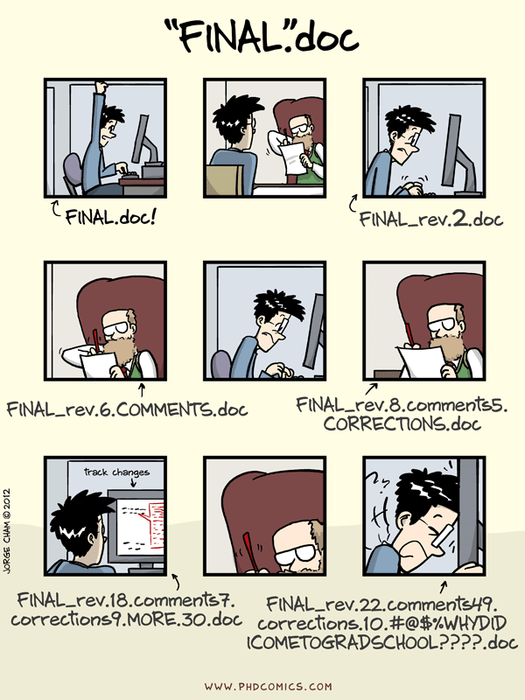
“Piled Higher and Deeper” by Jorge Cham, http://www.phdcomics.com

Slide 4
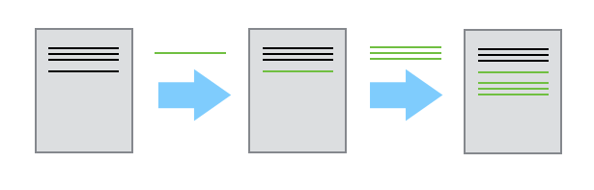
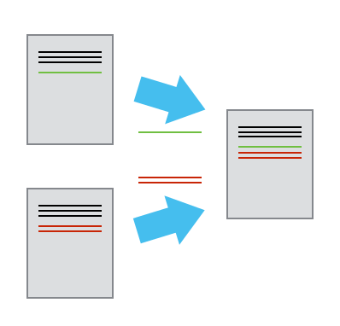
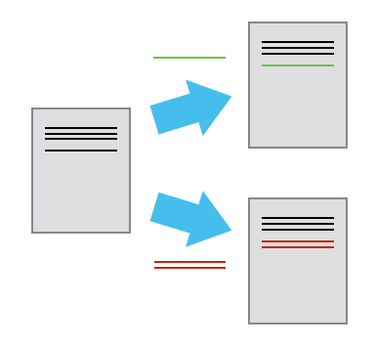

Slide 5
Setting Up Git
Questions
How do I get set up to use Git?
Objectives
Configure git the first time it is used on a computer.
Understand the meaning of the --global configuration flag.

Slide 6
Creating a Repository
Questions
Where does Git store information?
Objectives
Create a local Git repository.

Slide 7
Tracking Changes
Questions
How do I record changes in Git?
How do I check the status of my version control repository?
How do I record notes about what changes I made and why?
Objectives
Go through the modify-add-commit cycle for one or more files.
Explain where information is stored at each stage of Git commit workflow.

Slide 8
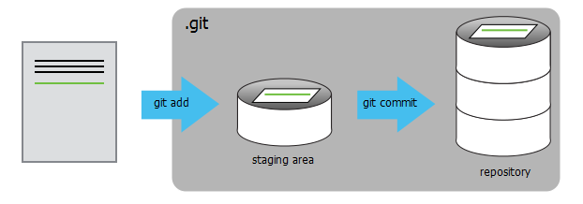

Slide 9
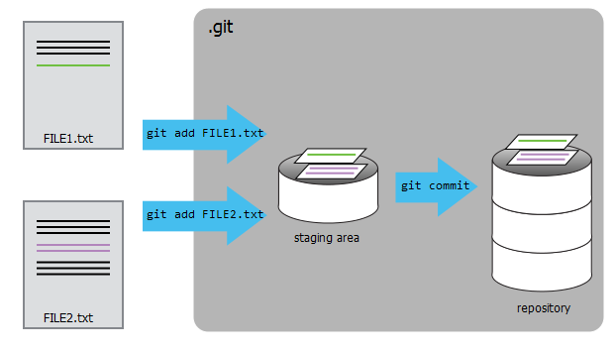

Slide 10
Exploring History
Questions
How can I identify old versions of files?
How do I review my changes?
How can I recover old versions of files?
Objectives
Explain what the HEAD of a repository is and how to use it.
Identify and use Git commit numbers.
Compare various versions of tracked files.
Restore old versions of files.

Slide 11
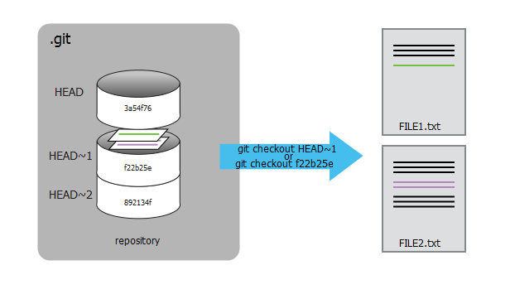

Slide 12
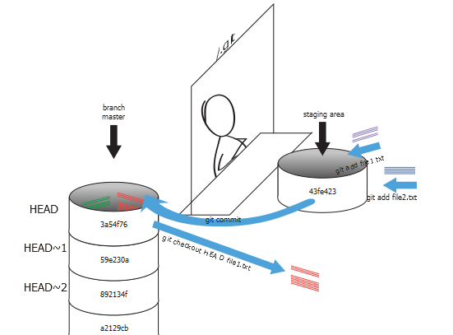

Slide 13
Ignoring Things
Questions
How can I tell Git to ignore files I don’t want to track?
Objectives
Configure Git to ignore specific files.
Explain why ignoring files can be useful.

Slide 14
Remotes in GitHub
Questions
How do I share my changes with others on the web?
Objectives
Explain what remote repositories are and why they are useful.
Push to or pull from a remote repository.

Slide 15
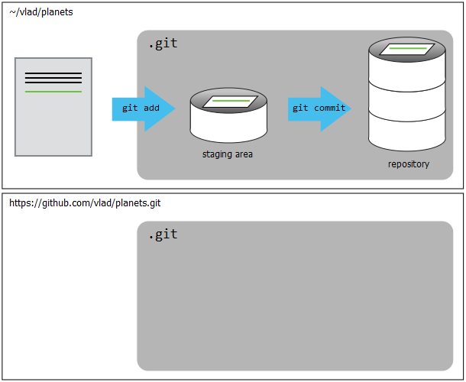

Slide 16
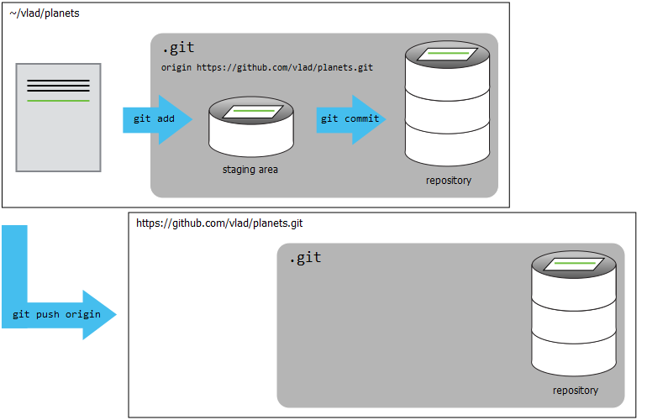

Slide 17
Collaborating
Questions
How can I use version control to collaborate with other people?
Objectives
Clone a remote repository.
Collaborate pushing to a common repository.

Slide 18
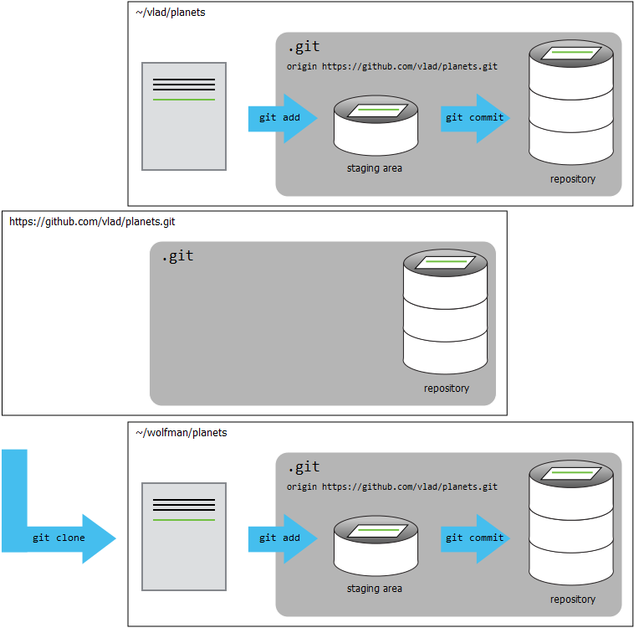

Slide 19
Conflicts
Questions
What do I do when my changes conflict with someone else’s?
Objectives
Explain what conflicts are and when they can occur.
Resolve conflicts resulting from a merge.

Slide 20
